Slide 1
Telecom Churn Case Study SUBMISSION
N Srinivas , Naresh Gunjalli, Abhishek P, Pramod I

Slide 2
Conclusion
There are two models which are performing well here. Naïve Bayes and Logistic Regression.
By looking into the accuracy, sensitivity, specificity and the AUC we select the Logistic regression model as the best model.
Factors Afffecting Churn | Remarks
tenure | We see that tenure has a negative coefficient, which is in accordance to our exploratory analysis. Customers churn early. So, maybe the company should extend more offers in the initial period to retain the customers.
ContractOne.year | Again, this is a negative coefficient, this actually indicates that it is better to have one or two year contracts.
ContractTwo.year | Same as above. Hence, it is better to move away from the monthly contract type and embrace annual contracts.
PaymentMethodElectronic.check | This is another indicator, which has a positive impact. So, it is better to avoid customers who prefer this method of payment or have special policies for their retention
MultipleLinesYes | This again has a positive impact. So, it is better to incentivize these customers who have multiple lines. They have a tendency to leave, maybe for another vendor.
InternetServiceFiber.optic | This has a very strong impact (close to 1). Hence, the company needs to analyse if there is a technical flaw in this mode of service or any policy changes need to be brought in place. Most people using this service churn.
InternetServiceNo | This has a negative impact. So, people who use these services do not really churn. So, there is probably lesser need for the company to incentivise such customers. Maybe, the cost of this service can also be increased.

Slide 3
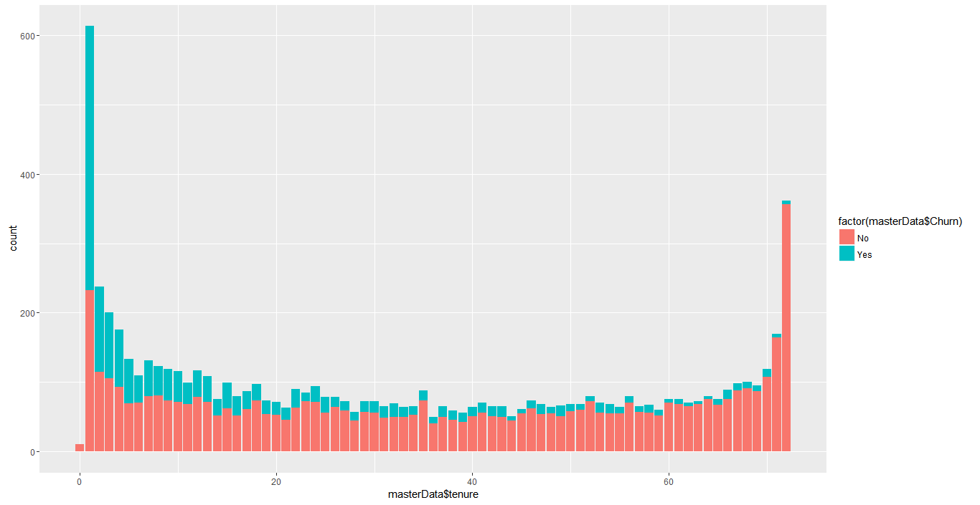
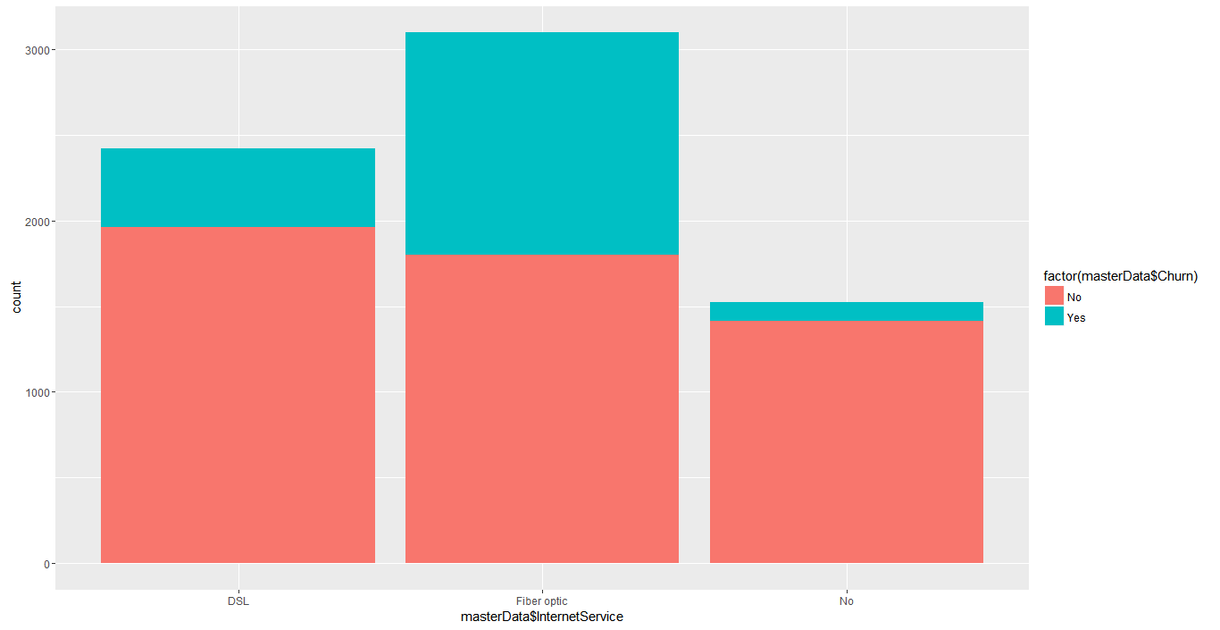
EDA plots and insights - 1
Impact of Type of Internet service
chosen on the Churn rate
Impact of Tenure on the Churn rate
Churn rate is very high for the new customers
Customers who opted for Fiber Optic Internet
connection have churned the most

Slide 4
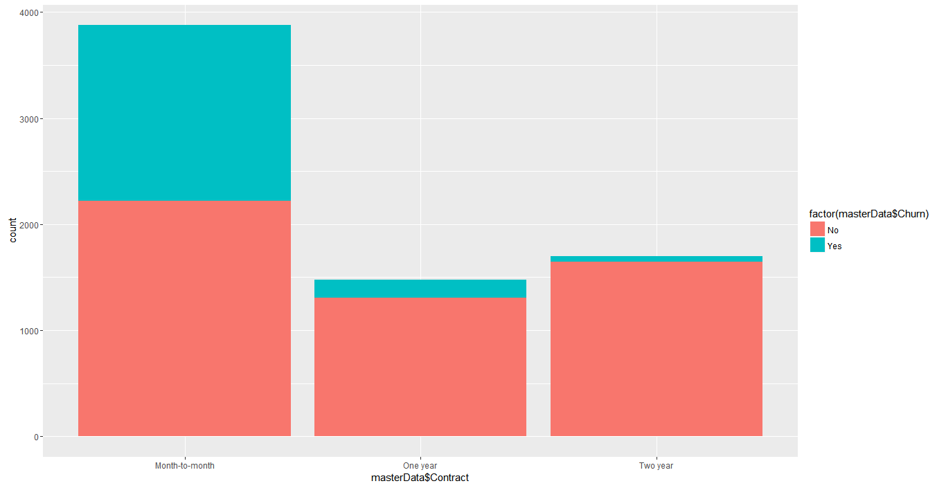
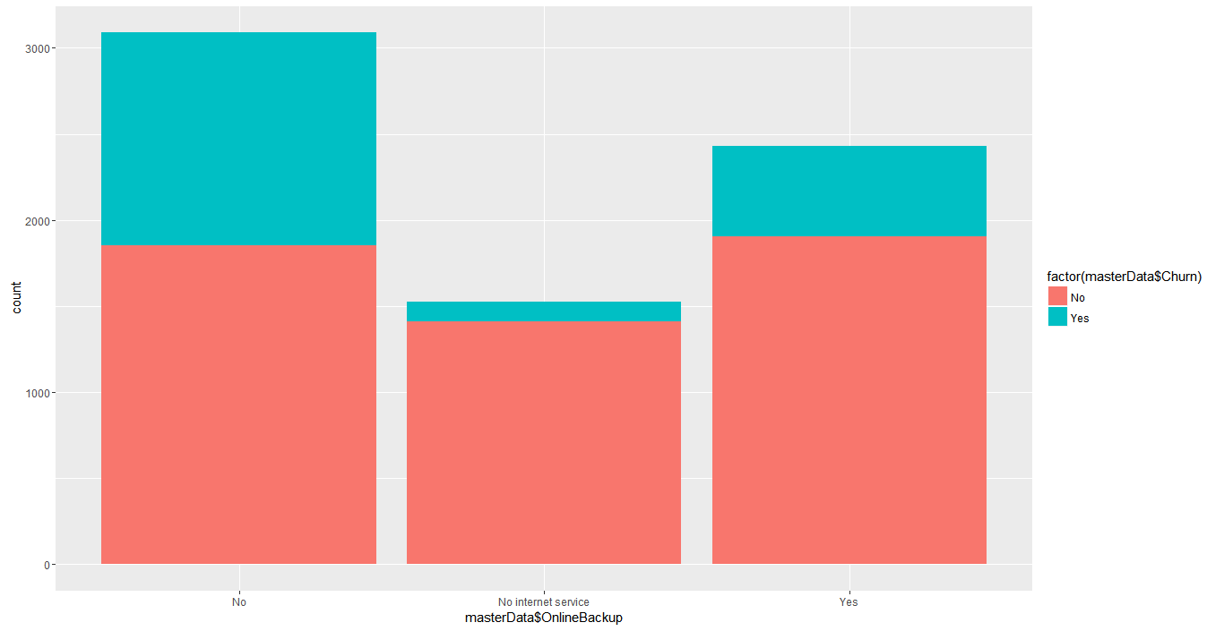
EDA plots and insights - 2
Impact of OnlineBackup service on the Churn rate
Impact of Contract type on the Churn rate
The churn rate is highest among people
choosing month-to-month contracts.
The churn is more among customers who
do not opt for online backup.

Slide 5
K-NN model insights and results
Report the final performance metrics and discuss the results and their implications.
Positive class in this model is Churn = “Yes”. We are interested in higher sensitivity of the model.
Looking into the accuracy, sensitivity and specificity values we could say that model is not performing well because sensitivity is less.
The sensitivity of 53.3% says that there are more false negatives predicted in this model i.e. even if the customer churn we are predicting that the customer is not going to churn. There is a risk here. We don’t want to miss predicting the customers who are going to churn.
The specificity of 88.72% says that there are very less false positives predicted in this model. False positive here is predicting the customer will churn who will actually not churn. Even if the specificity was less it wouldn’t have impacted a lot.
Threshold value | Values (Numeric)
Overall Accuracy | 0.7932
Sensitivity | 0.5330
Specificity | 0.8872
AUC | 0.2513972

Slide 6
Naïve Bayes model insights and results
Report the final performance metrics and discuss the results and their implications.
Positive class in this model is Churn = “No”. We are interested in higher specificity of the model.
Looking into the accuracy sensitivity and specificity values we could say that model is performing well.
The sensitivity of 61.21% says that there are more false negatives predicted in this model i.e even if the customer will not churn we predict the customer is going to churn. No risk here.
The specificity of 86.27% says that there are very less false positives predicted in this model. False positive here is predicting the customer will not churn who will actually churn. It is required to have this value less because we cant afford to miss to identify customers who will churn.
Threshold value | Values (Numeric)
Overall Accuracy | 0.6787
Sensitivity | 0.6121
Specificity | 0.8627
AUC | 0.7374

Slide 7
Logistic Regression model insights and results
The most important variables which will affect the churn are below.
tenure, ContractOne.year , ContractTwo.year and InternetServiceNo will impact negatively for the churning of the customer.
PaymentMethodElectronic.check, MultipleLinesYes and InternetServiceFiber.optic will impact positively for the churning of the customer.
Significant variables in final model (add more rows if requires) | Coefficients value (Numeric)
(Intercept) | -0.598242
tenure | -0.033134
ContractOne.year | -0.754504
ContractTwo.year | -1.657352
PaymentMethodElectronic.check | 0.530221
MultipleLinesYes | 0.404304
InternetServiceFiber.optic | 0.958977
InternetServiceNo | -0.791459

Slide 8
Logistic Regression model insights and results
Report the final performance metrics and discuss the results and their implications. Also, discuss the most important variables and their impact on churn.
Positive class in this model is Churn = “Yes”. We are interested in higher sensitivity of the model.
Looking into the accuracy sensitivity and specificity values we could say that model is performing well.
The sensitivity of 82.35% says that there are very less false negatives predicted in this model. False negatives are the categories where we predict that customer will not churn who will actually churn. As the FN are less, model is performing good.
The specificity of 65.21% says that there are less false positives predicted in this model. False positive here is predicting the customer will churn who will actually not churn.
Threshold value | Values (Numeric)
Overall Accuracy | 0.6976
Sensitivity | 0.8235
Specificity | 0.6521
AUC | 0.8349

Slide 9
SVM Model insights and results
Report the final performance metrics and discuss the results and their implications.
Positive class in this model is Churn = “No”. We are interested in higher specificity of the model.
Looking into the accuracy sensitivity and specificity values we could say that model is not performing well because specificity is less.
The sensitivity of 90.01% says that there are very less false negatives predicted in this model i.e even if the customer will not churn we predict the customer is going to churn, which is good.
But, the specificity of 51.52% says that there are more false positives predicted by this model. False positive here is predicting the customer will not churn who will actually churn. It is required to have this value more because we cant afford to miss to identify customers who will churn. But as this is low, model is not performing well.
Threshold value | Values (Numeric)
Overall Accuracy | 0.7979
Sensitivity | 0.9001
Specificity | 0.5152
AUC | 0.70018

